Slide 1


Slide 2
NoSQL Database Architecture Intro to NoSQL Databases
NoSQL Databases (DSO-553)

Slide 3
DSO 553 - Overview
Syllabus & Course Schedule
Learning Objectives & Gradin
Questions

Slide 4
Big Data and the Birth of NoSQL
“Every two days, we create as much information as we did from the dawn of civilization until 2003.” - Eric Schmidt
-3Vs of Big data: Volume, Velocity, Variety
-Structured, Semi-structured, Unstructured data

Slide 5
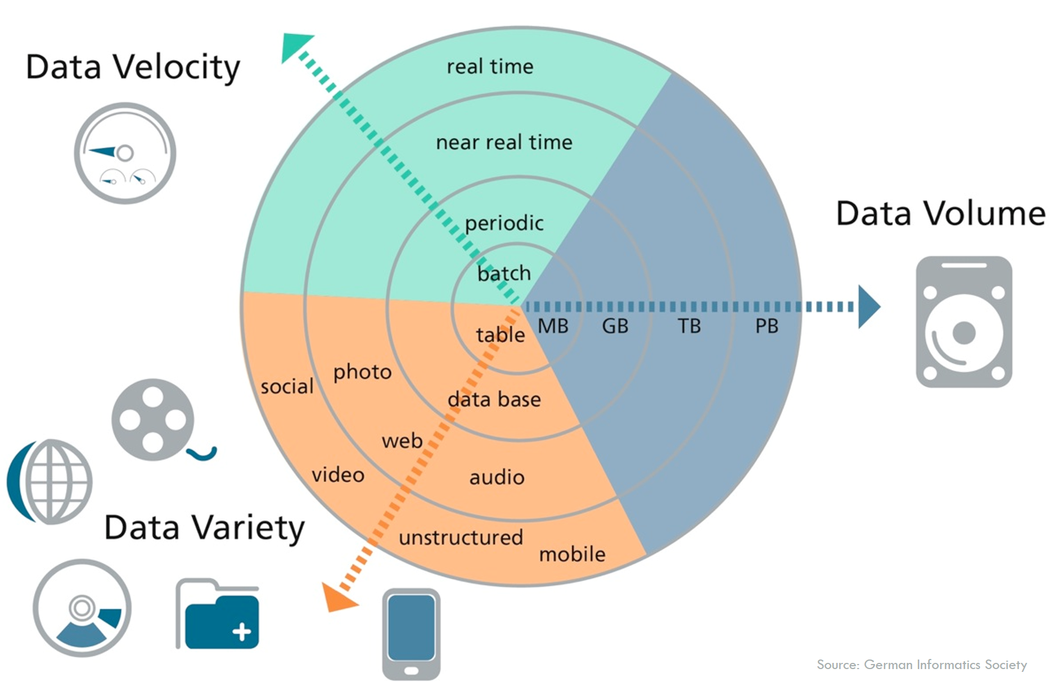
Big Data - cont’d

Slide 6
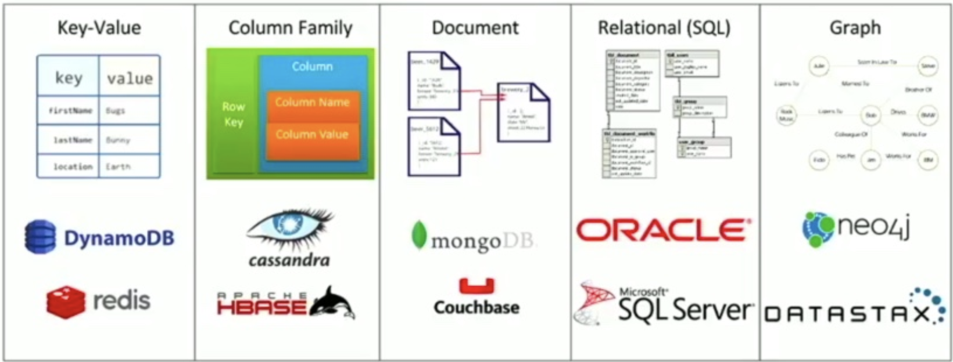
Birth of NoSQL

Slide 7
NoSQL (non-relational) and SQL (relational) Systems

Slide 8
ACID vs BASE
Homogeneous data vs Heterogeneous
Schema vs Schema-less
Data Independence vs Access Patterns
Notes:
-ACID transactions
-BASE
https://www.voltdb.com/blog/2015/10/22/disambiguating-acid-cap/
-Types of Data (unstructured vs structured data)
https://www.google.com/url?sa=i&source=images&cd=&ved=2ahUKEwjusaPI9oLnAhXTvZ4KHXu_AtAQjRx6BAgBEAQ&url=https%3A%2F%2Fwww.researchgate.net%2Ffigure%2FThe-CAP-Theorem-Many-of-the-NOSQL-databases-have-loosened-up-the-requirements-on_fig5_324922396&psig=AOvVaw3PtO9dKM2ILB0yoG6xB4Q2&ust=1579085536135602

Slide 9
What is CAP theorem? And how does it apply?
Notes:
Here’s my history. Now lets start with a short history of why NoSQL sprung about - i.e. a short history of NoSQL so you can understand it in context

Slide 10
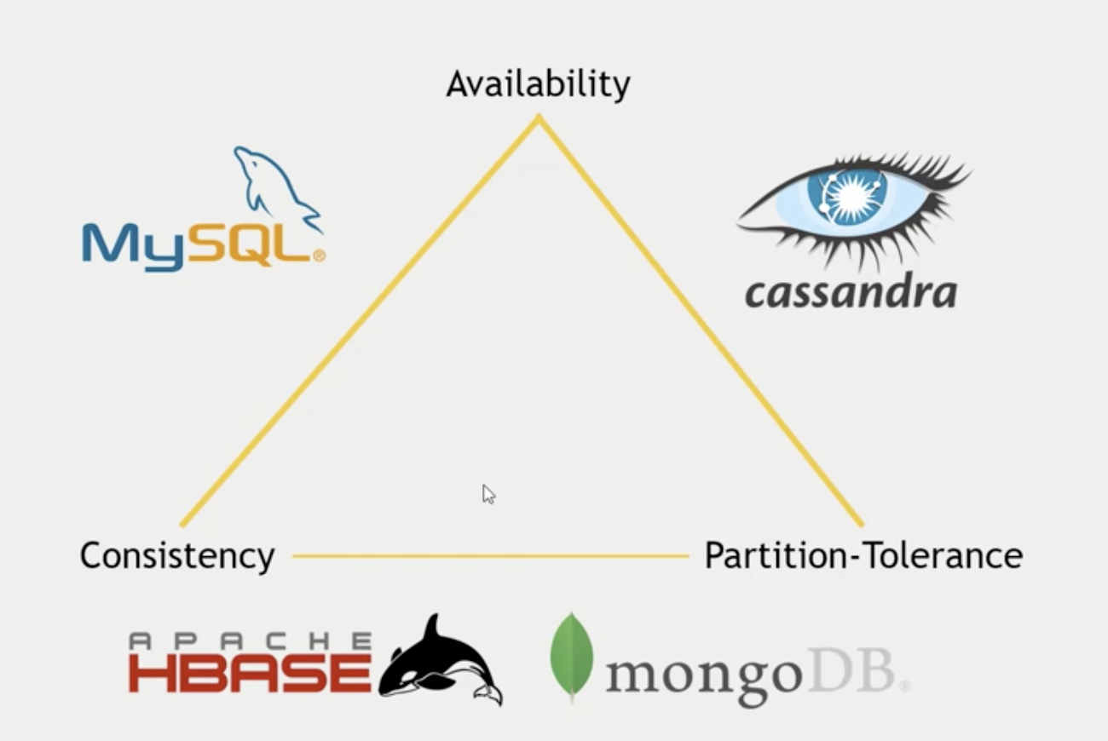
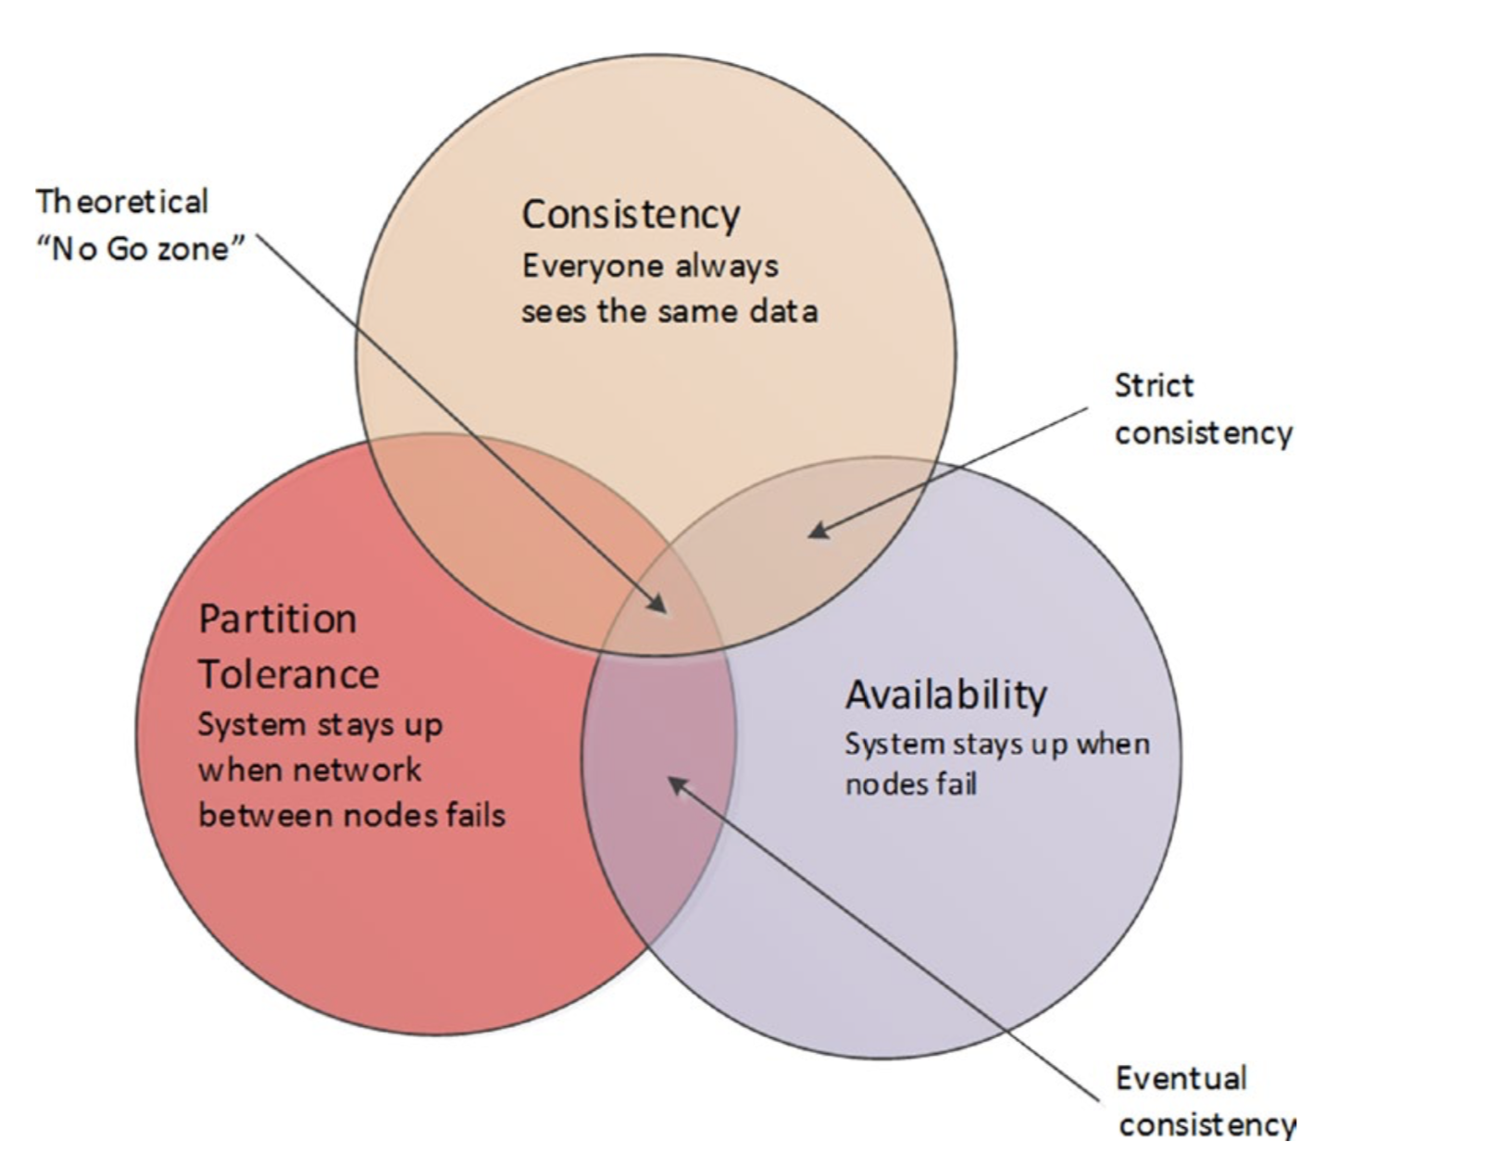

Slide 11
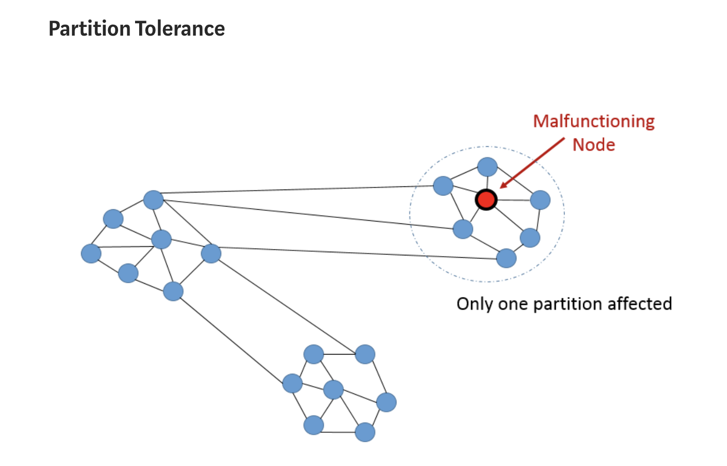

Slide 12
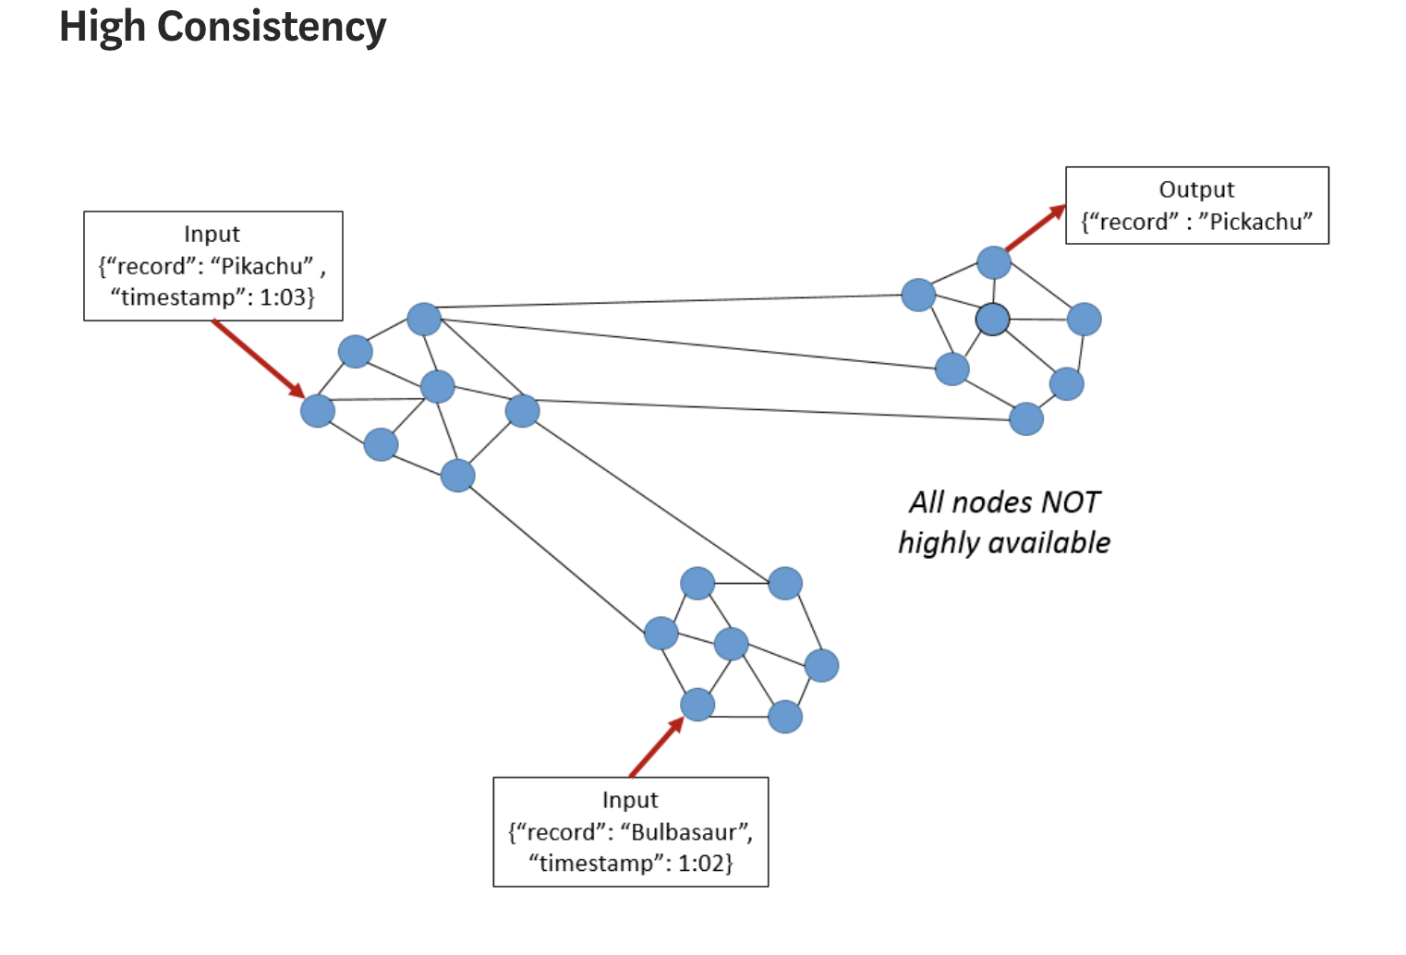

Slide 13
Document Databases

Slide 14
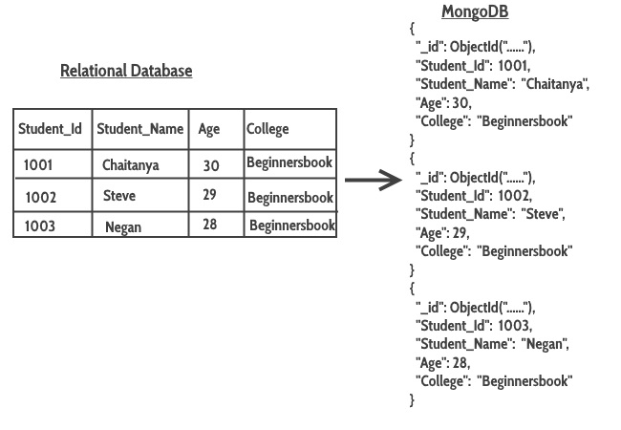
Collection
Document

Slide 15
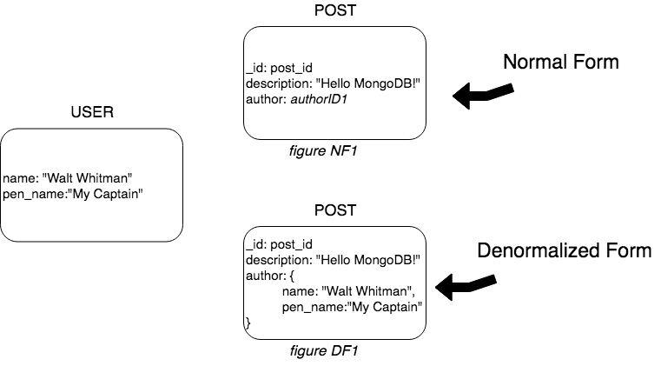
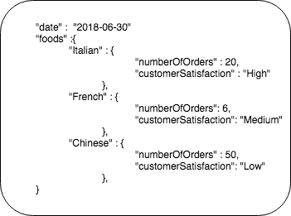
MongoDB Tips
Tip 2: Array vs Nested document
Tip 1: Embed vs Reference
Embedding or referencing are different relationship patterns in MongoDB. Arrays or nested are embedding implementations

Slide 16
Graph Databases

Slide 17
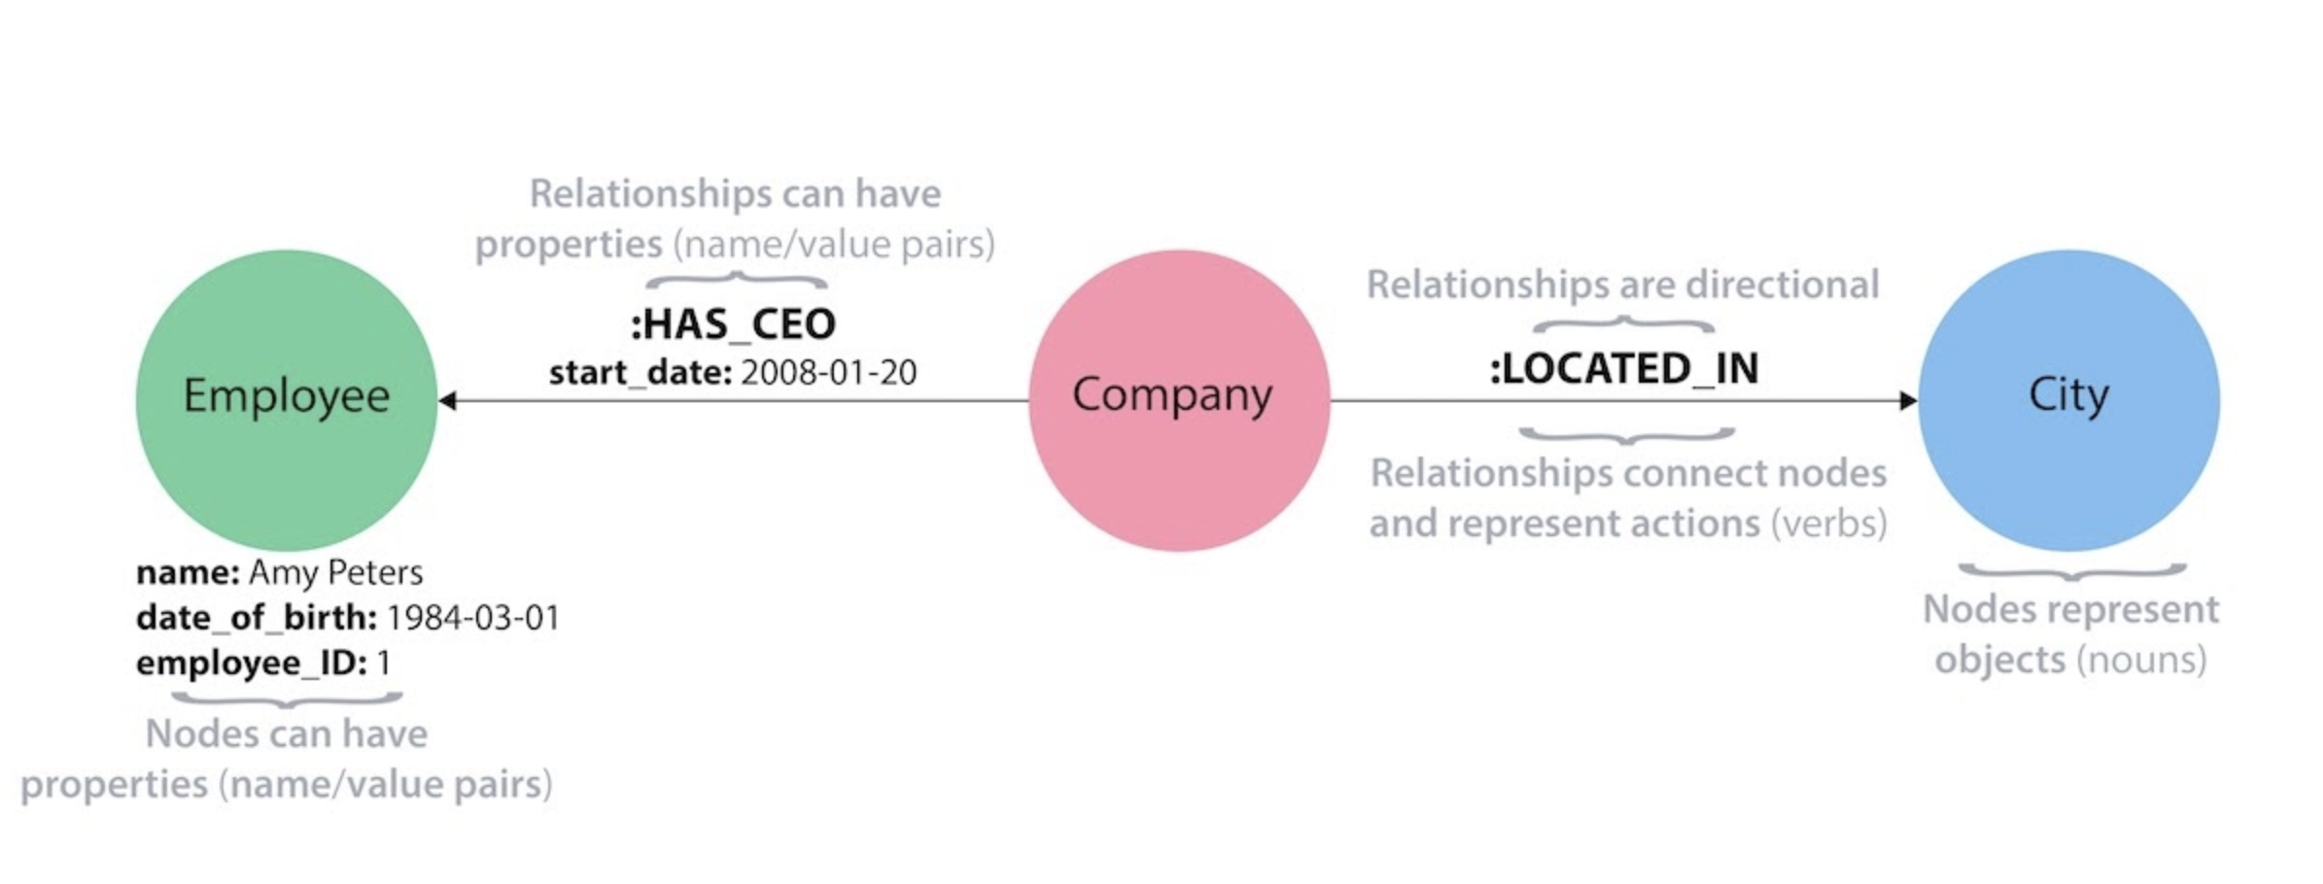
Labels i.e. group/collection of similar nodes (e.g. Employee, Company, City)
Relationship Types i.e. group/collection of relationships e.g. :LOCATED_IN, :HAS_CEO
Notes:
Patterns and clauses

Slide 18
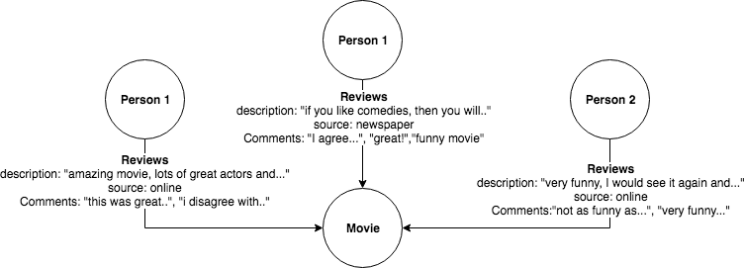
Neo4j Tips
Tip 1:Rich Properties, Tip 2: Entity vs Relationships vs Property

Slide 19
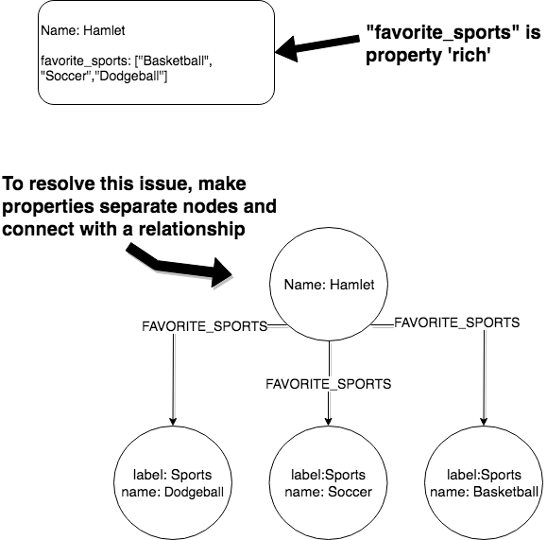
Neo4j Tips

Slide 20
Column Databases

Slide 21
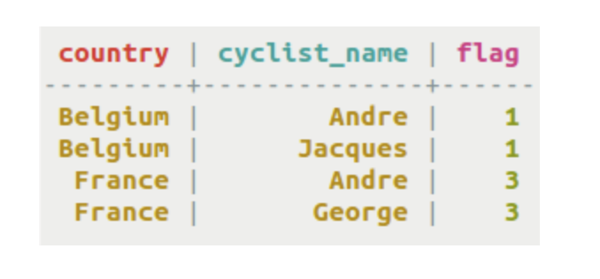
Cycling Table
Notes:
SELECT count(cyclist_name) FROM Cycling WHERE country= “Belgium”;
SELECT sum(flag) FROM Cycling WHERE country= “Belgium”;
https://medium.com/@wishmithasmendis/from-rdbms-to-key-value-store-data-modeling-techniques-a2874906bc46
https://techannotation.wordpress.com/2018/02/15/data-model-in-redis/

Slide 22
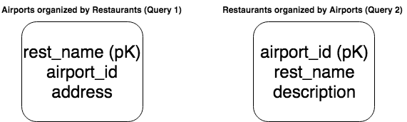
Cassandra Tips
Tip 1:
No Joins or foreign keys
Tip 2: New Query, New Table
Query 1: Find restaurants near an airport
Query 2: Around an airport find restaurants
Notes:
No Joins, so, normally, denormalize
Query Specific

Slide 23
Key-Value Databases

Slide 24
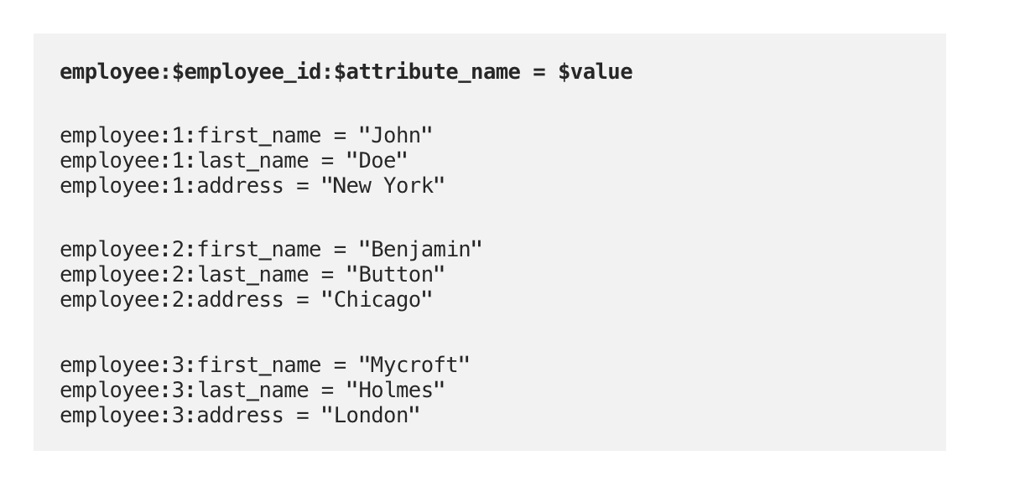
Notes:
https://medium.com/@wishmithasmendis/from-rdbms-to-key-value-store-data-modeling-techniques-a2874906bc46
https://aws.amazon.com/nosql/key-value/
https://techannotation.wordpress.com/2018/02/15/data-model-in-redis/

Slide 25
NoSQL Family Recap
Document
Deeply nested data and general purpose database
Column
Columns, not rows. Always, always highly tailored for queries.
Graph
Relationships, relationships and more relationships. All about relationships.
Key-Value
Fast, non-complex data access patterns and uses

Slide 26
CASE STUDIES

Slide 27
Case Study 1:
Online Bookstore (e.g. Amazon)

Slide 28
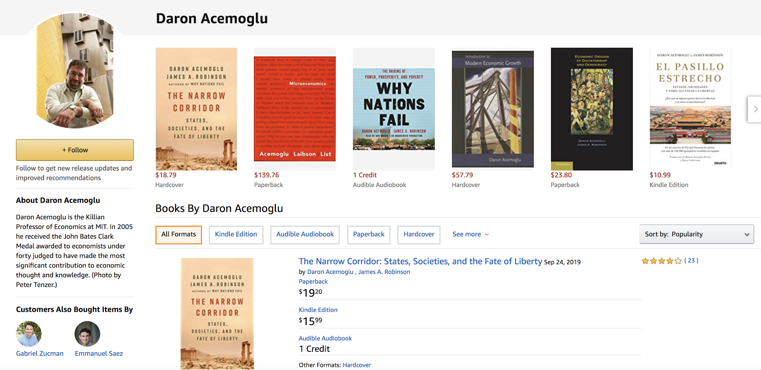
Notes:
https://www.amazon.com/Daron-Acemoglu/e/B001H6IPC6?ref=sr_ntt_srch_lnk_2&qid=1578988865&sr=1-2

Slide 29
Book List
Suggestions
Categories by Author
Notes:
https://www.amazon.com/Daron-Acemoglu/e/B001H6IPC6?ref=sr_ntt_srch_lnk_2&qid=1578988865&sr=1-2

Slide 30
Suggestion of Authors - Graph
Book List - Document
Categories by Author - SQL, Cassandra, Document

Slide 31
Case Study 2:
Online Hotel Booking Application (e.g. Expedia, Kayak, etc)

Slide 32
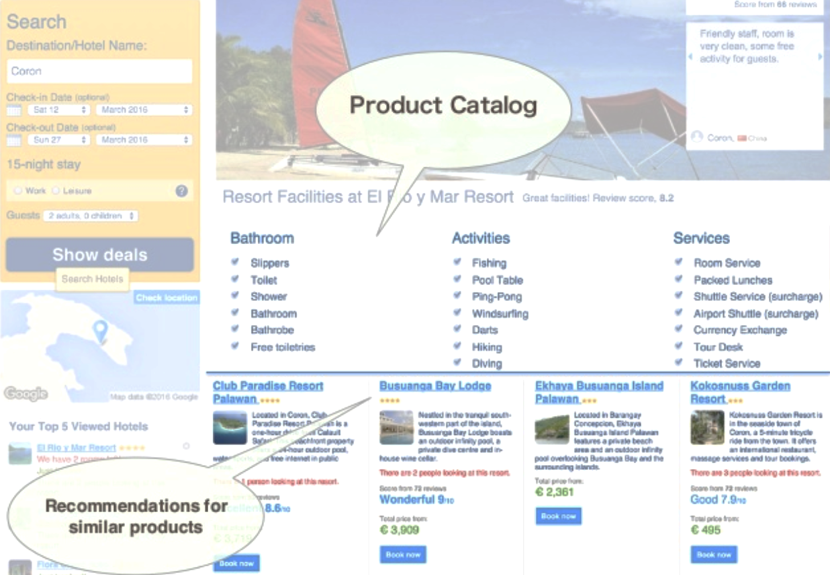

Slide 33
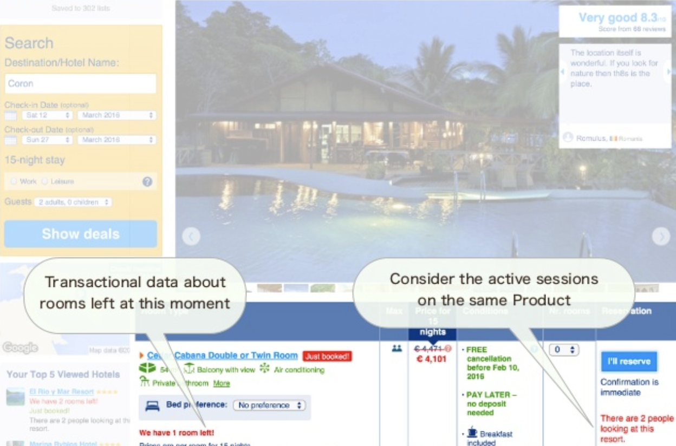

Slide 34
Recommendation - Neo4j
Product Catalog - MongoDB
Transactional Data - SQL
User sessions - Key-Value

Slide 35
Case Study 3:
Photo-Sharing Application (e.g. Instagram)

Slide 36
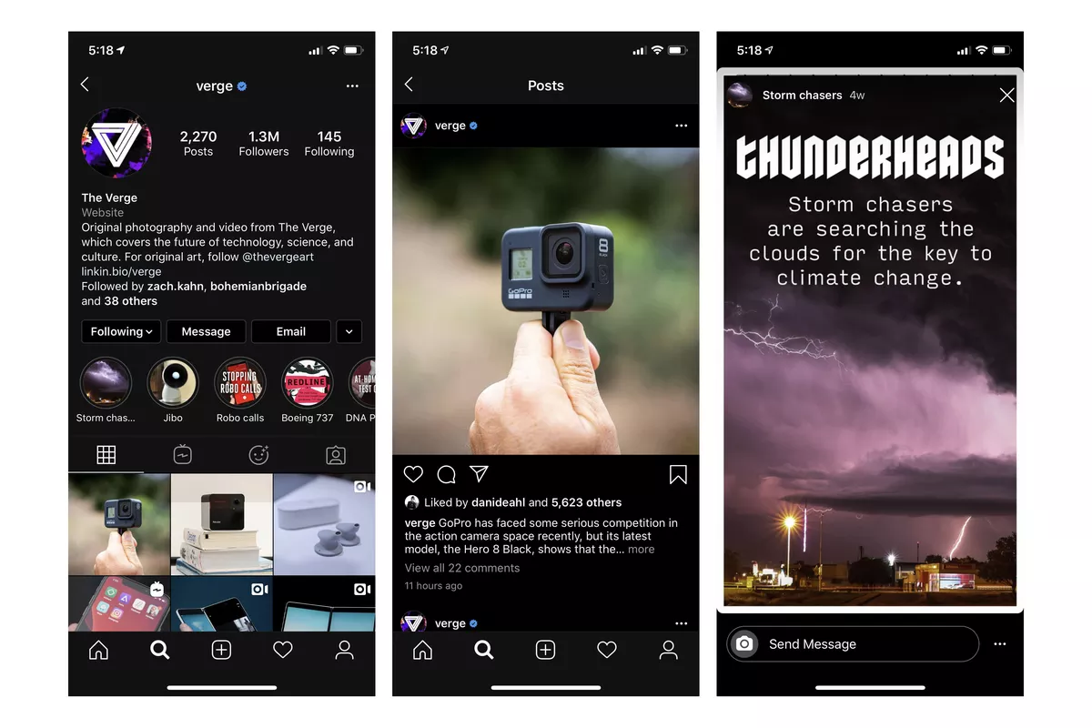
Notes:
https://www.google.com/url?sa=i&source=images&cd=&cad=rja&uact=8&ved=2ahUKEwj-yNbnw4LnAhWeIjQIHSaSAA8QjRx6BAgBEAQ&url=https%3A%2F%2Fwww.theverge.com%2F2019%2F10%2F7%2F20903897%2Finstagram-dark-mode-apple-ios-13-iphone-setting-update&psig=AOvVaw1JI0YVCdGdh_TLmAA5GG9W&ust=1579071496748347

Slide 37
Home/layout (middle) - ?
Profile Page - ?
Messaging - ?

